Slide 1
Fantasy Football Points Projection System
By Amar Srinivas

Slide 2


Motivation Behind the Project:
- Fantasy Football is a huge part of the sports culture in the United States and helps the casual fan get more involved in the sport.
- Many people set their starting lineups based on the projections given to them by various fantasy football sites.
- However, these projections consistently fall short of the predicted point total and negatively affect people’s chances of winning their games
- I wanted to figure out which sites provided more accurate projections and then build a model that can accurately project points totals for players

Slide 3
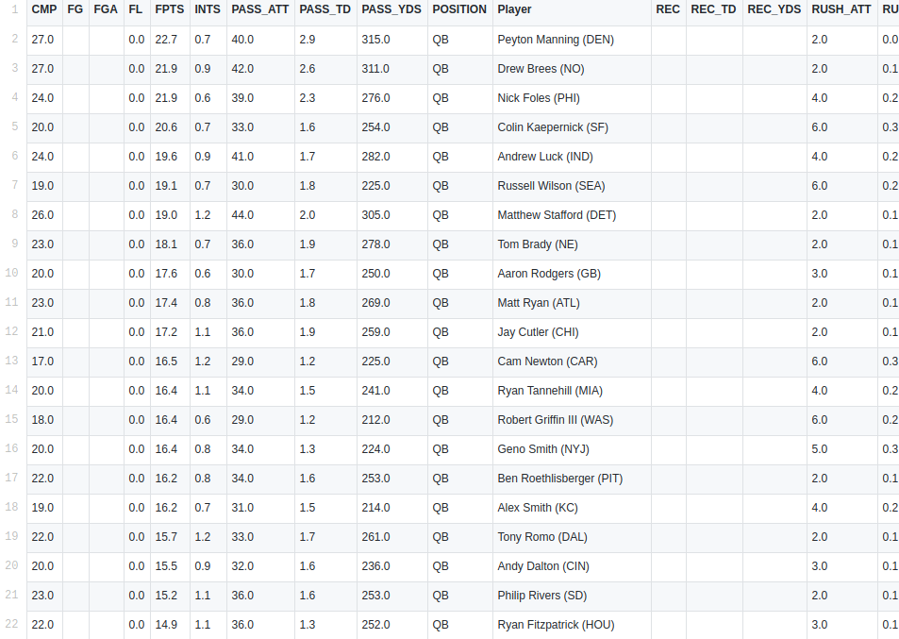
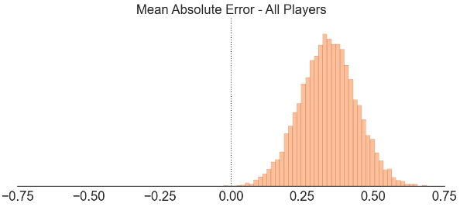
Gathering the Data
- The first step to create my model was to scrape ESPN, CBS, numberFire and other prognosticators for the relevant data that was needed.
- Once the data had been gathered I had to do some fundamental EDA and see which columns had irrelevant and unnecessary data
- I decided that to show which sites had more accurate predictions, I should use absolute and relative error as metrics.

Slide 4
Feature Engineering & Importance
- After dealing with the raw data, I had to figure out next which features directly impact player performance.
- My intuition was that

